Slide 1

Holistic Workforce
PRESENTED BY:
AUM NARESH CHALKE

Slide 2
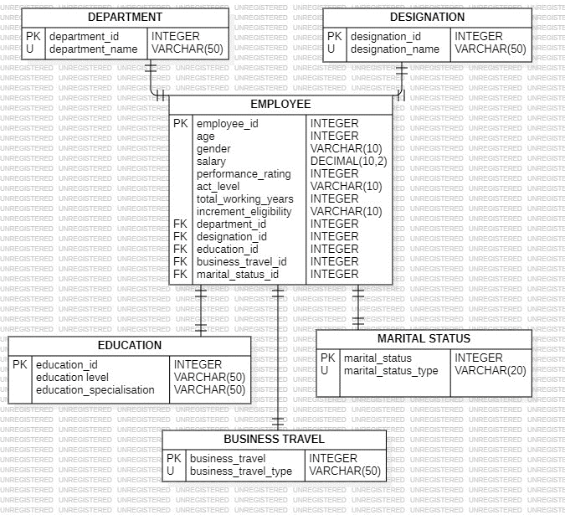
ER DiaGRAM

Slide 3

Structure of the table

Slide 4
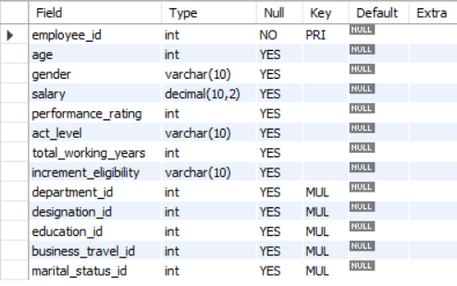
Employee TABLE
IT DESCRIBES THE STRUCTURE OF THE EMPLOYEE TABLE
SYNTAX:
desc employee;

Slide 5

Department TABLE
IT DESCRIBES THE STRUCTURE OF THE DEPARTMENT TABLE
SYNTAX:
desc DEPARTMENT;

Slide 6

Designation TABLE
IT DESCRIBES THE STRUCTURE OF THE DESIGNATION TABLE
SYNTAX:
desc DESIGNATION;

Slide 7

Education TABLE
IT DESCRIBES THE STRUCTURE OF THE EDUCATION TABLE
SYNTAX:
desc EDUCATION;

Slide 8

Business travel TABLE
IT DESCRIBES THE STRUCTURE OF THE BUSINESS TRAVEL TABLE
SYNTAX:
desc BUSINESS_TRAVEL;

Slide 9

Marital status TABLE
IT DESCRIBES THE STRUCTURE OF THE MARITAL_STATUS TABLE
SYNTAX:
desc MARITAL_STATUS;

Slide 10

SUBQUERIES

Slide 11
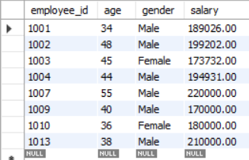
Employees with a Higher Salary than the Average Company Salary
SYNTAX:
SELECT employee_id, age, gender, salary
FROM employee
WHERE salary >( SELECT AVG(salary) FROM employee);

Slide 12
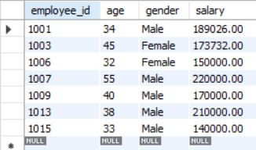
Find employees with a salary greater than the average salary of their respective department
SYNTAX:
SELECT employee_id, age, gender, salary
FROM employee e
WHERE salary > (SELECT AVG(salary)
FROM employee
WHERE department_id = e.department_id);

Slide 13

Find the department name of the youngest employee
SYNTAX:
SELECT department_name
FROM department
WHERE department_id = (SELECT department_id FROM employee
WHERE age = (SELECT MIN(age) FROM employee));

Slide 14
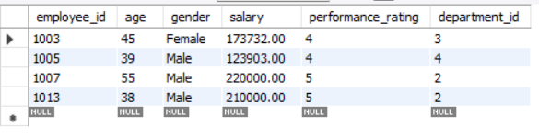
Employees with Higher Performance Rating than the Average in Their Department
SYNTAX:
SELECT employee_id, age, gender, salary, performance_rating, department_id FROM employee e WHERE performance_rating > ( SELECT AVG(performance_rating) FROM employee WHERE department_id =e.department_id);

Slide 15

JOINS

Slide 16
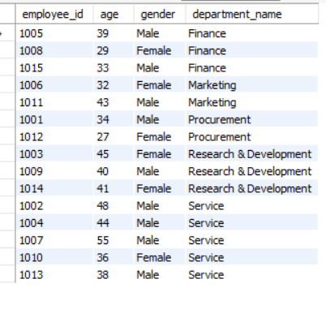
List all employees with their department names
SYNTAX:
SELECT e.employee_id, e.age, e.gender, d.department_name
FROM employee e
JOIN department d
ON e.department_id =d.department_id;

Slide 17
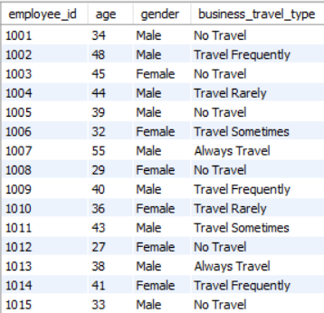
List employees and their business travel type
SYNTAX:
SELECT e.employee_id, e.age, e.gender, bt.business_travel_type
FROM employee e
left JOIN business_travel bt
ON e.business_travel_id=bt.business_travel_id;

Slide 18
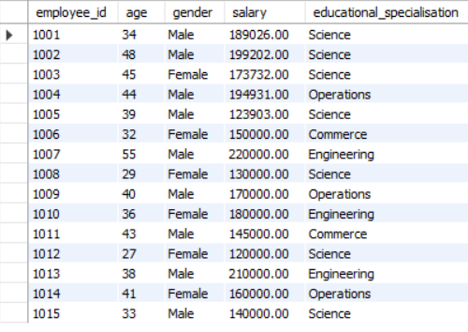
List all employees and their educational specialization
SYNTAX:
SELECT e.employee_id, e.age, e.gender, e.salary, edu.educational_specialisation
FROM employee e
LEFT JOIN education edu
ON e.education_id = edu.education_id;

Slide 19
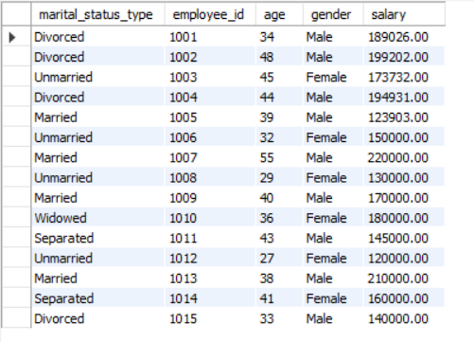
List all marital statuses and the employees who have those statuses
SYNTAX:
SELECT ms.marital_status_type, e.employee_id, e.age, e.gender, e.salary
FROM marital_status ms
RIGHT JOIN employee e
ON
ms.marital_status_id = e.marital_status_id;

Slide 20
ThANK YOU

